Slide 1


Cyclistic bike-share analysis
Year 2023
An understanding of consumer habits following the closure of the previous year. What habits do members/casual riders exhibit and how do we market towards an improved consumer experience.

Slide 2

Cyclistic bike-share analysis
Year 2023
Comprehensive insight into consumer behaviors post the previous year's closure, focusing on the habits displayed by both members and casual riders. Analyzing these habits enables us to tailor marketing strategies towards enhancing the overall consumer experience.

Slide 3

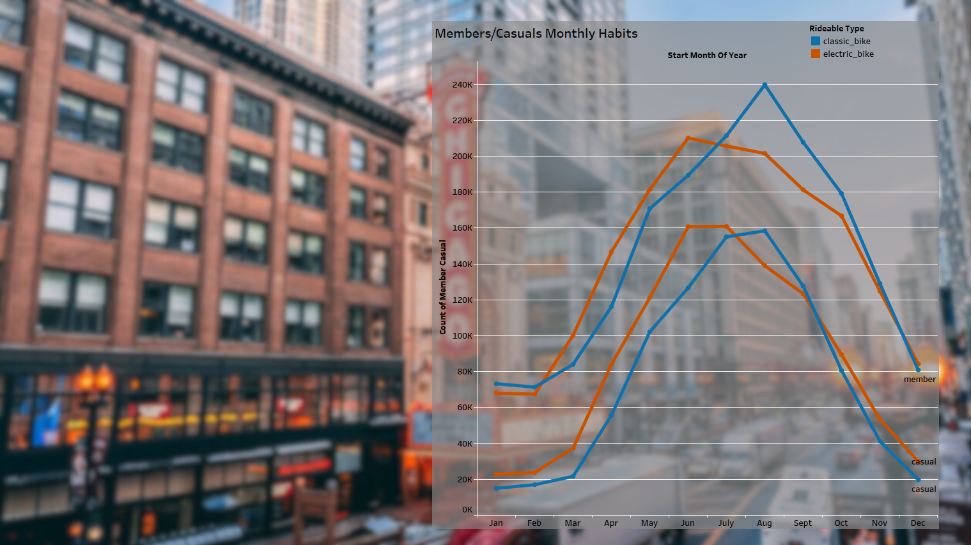
Monthly analysis for the year 2024
The usage of classic bikes reaches its peak during the warmer summer months.
Electric bikes emerge as the preferred mode of transportation, with classic bikes gaining traction in the later months.

Slide 4
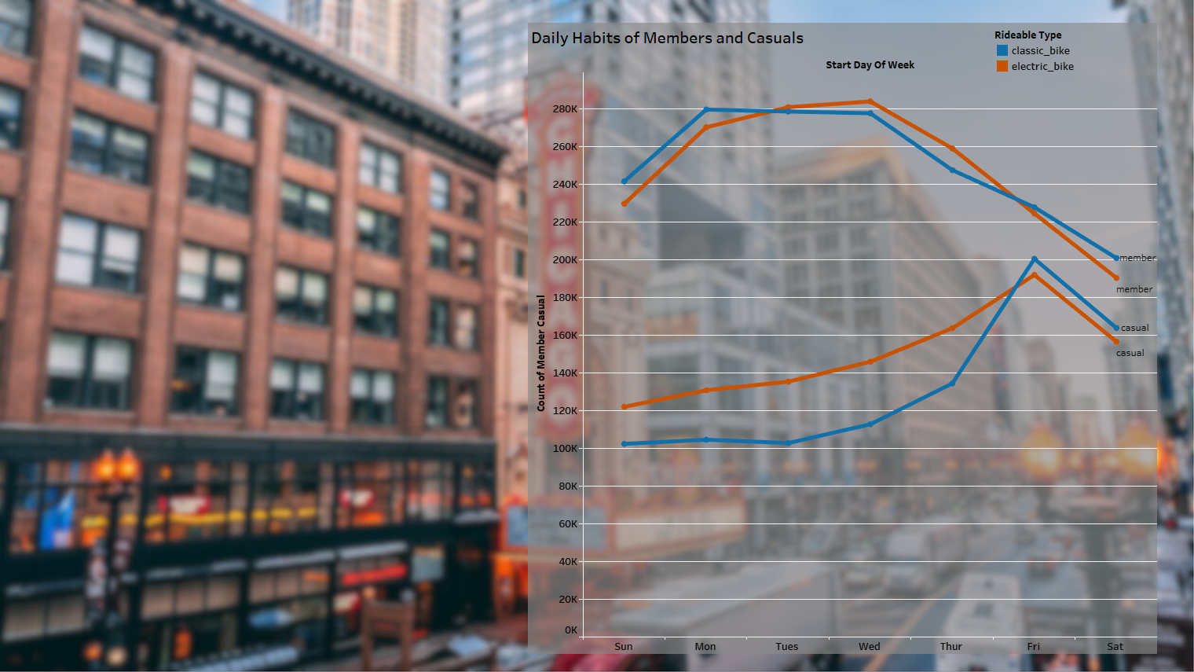

Slide 5
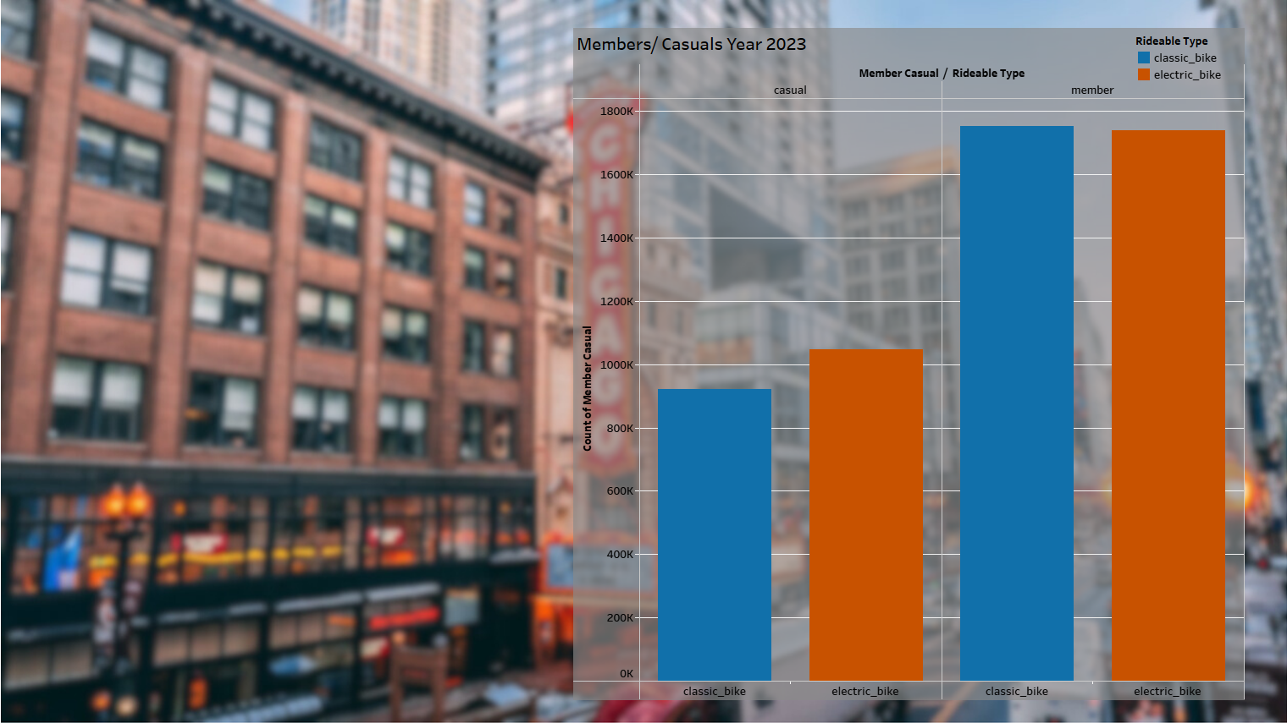
Analysis of members and casual riders in the year 2023
Both columns for members show an approximate increase of 1 million people.

Slide 6
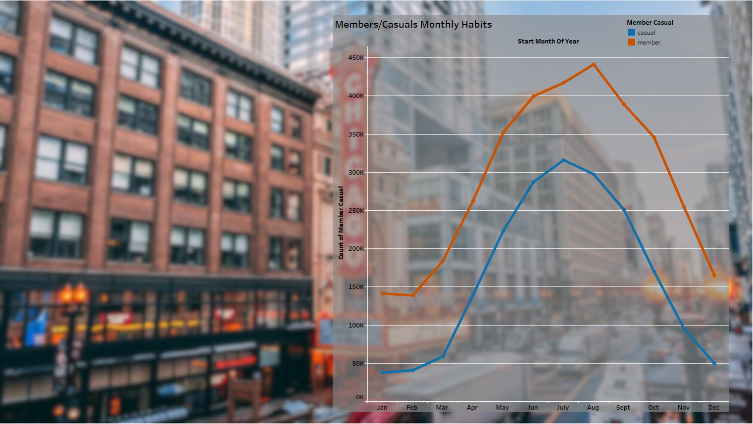
Analysis of members and casual riders by month in the year 2023
Each line reflects the other; we should concentrate on increasing our casual share to align with it.
Discounts should be offered to casual riders during the winter months to encourage riding.

Slide 7

Analysis of classic and electric bike usage by month in the year 2023
Classic bikes only overtake electric bikes in the cool fall months.
June-July is the preference change, marketing should reflect this.

Slide 8
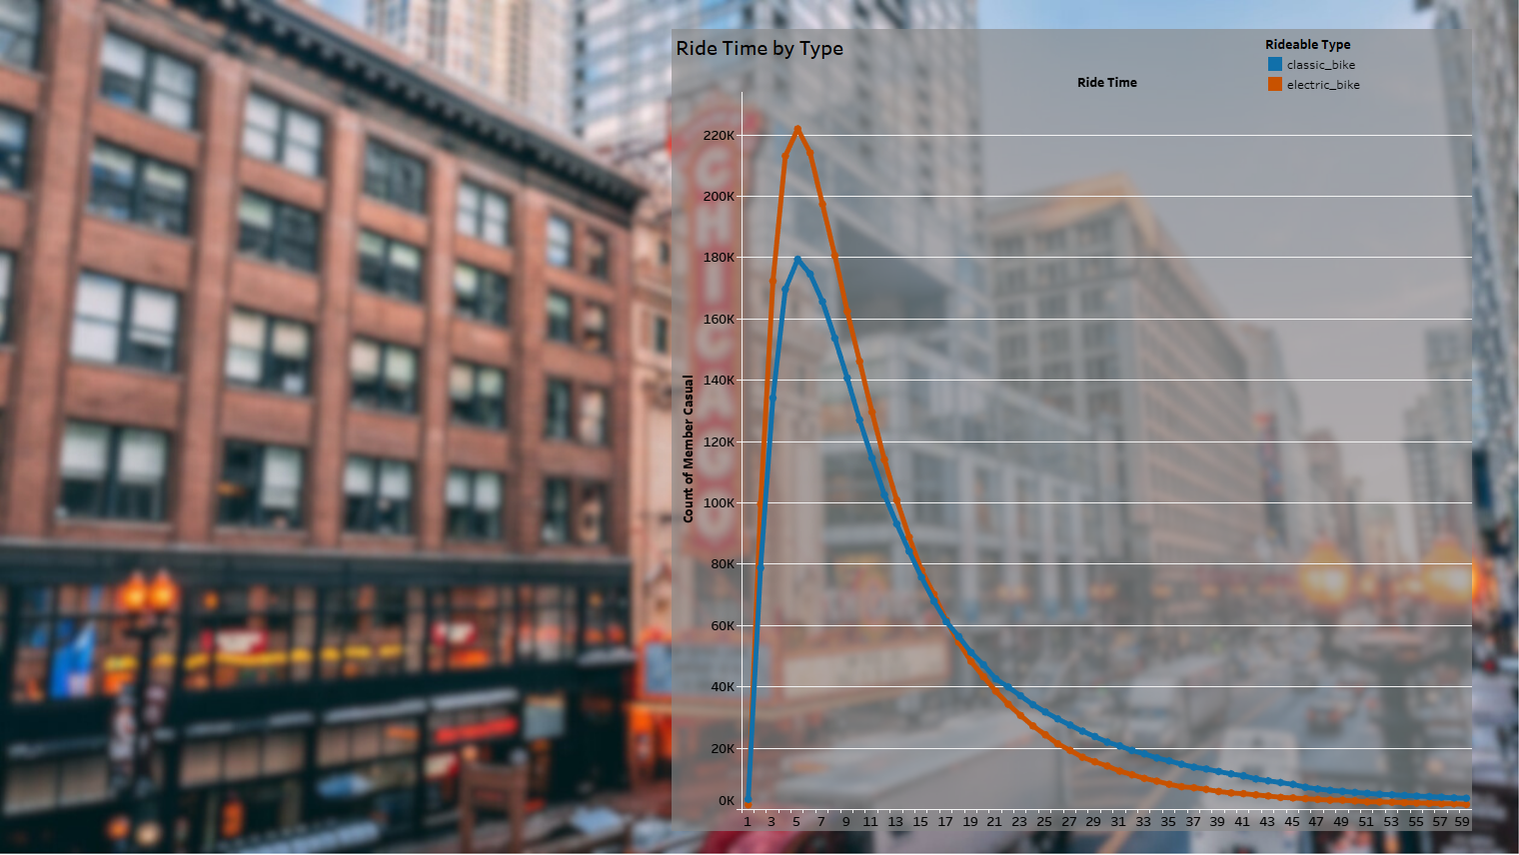
Analysis of ride lengths in the year 2023
75% of rides last less than 1 hour.
Most rides typically last for approximately 5 minutes.
Classic bikes are typically utilized for longer rides.

Slide 9
The following two slides are hypothetical. This was done to express more data and practice presentation ideas.

Slide 10
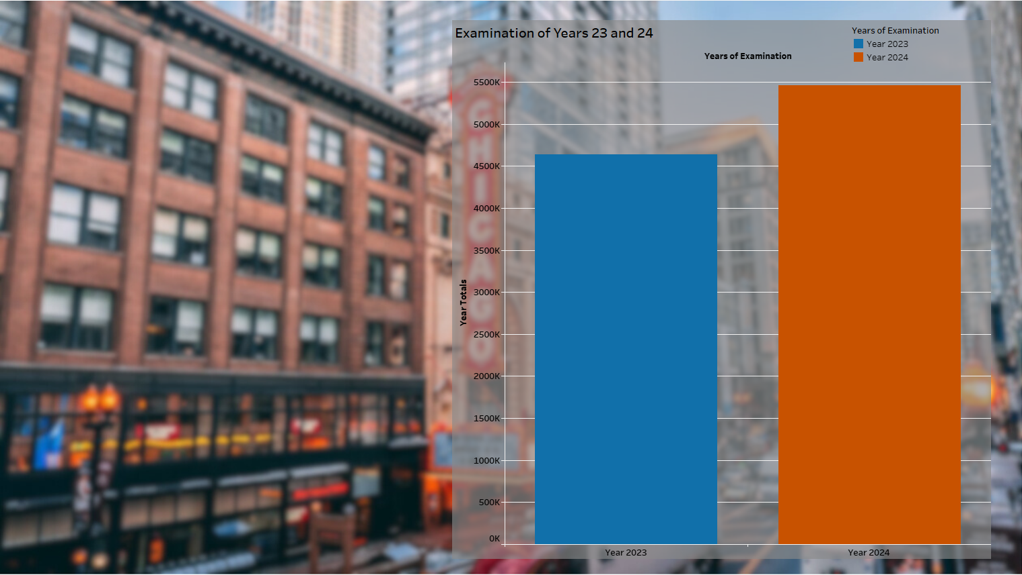
Year-to-year analysis
We experienced a 15% increase across all metrics.
Reported User satisfaction has increase by 7%.

Slide 11
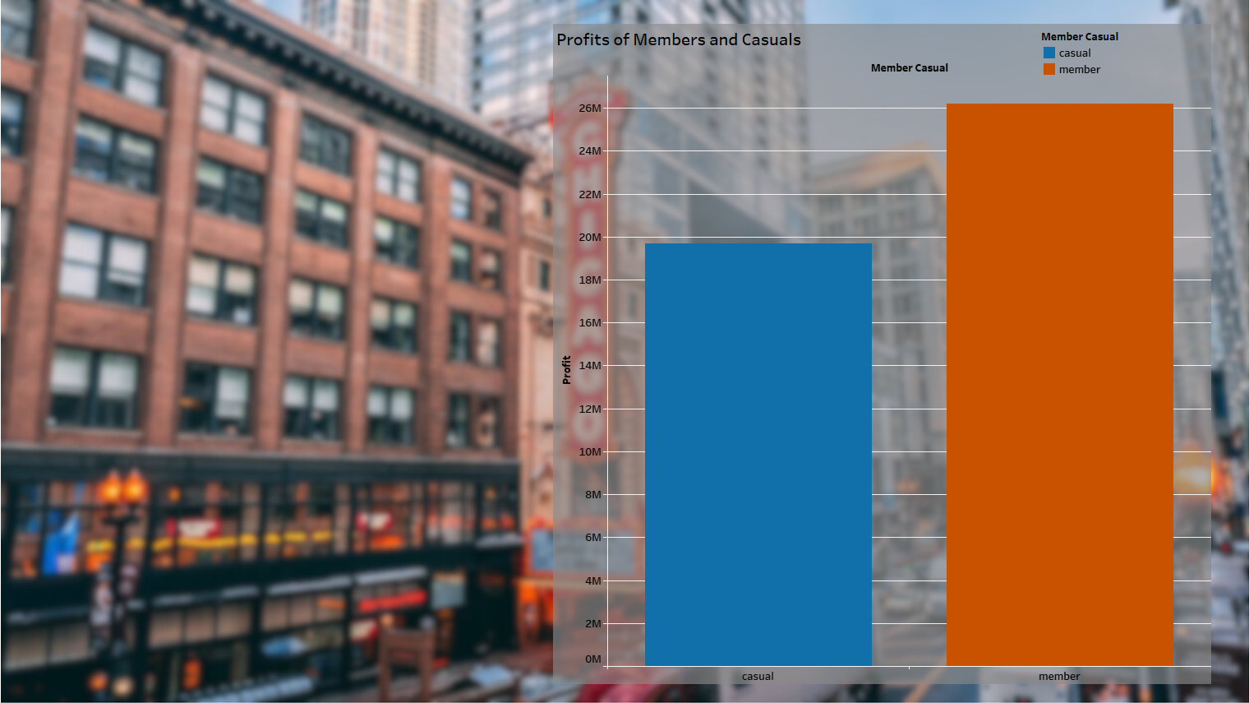
Year-to-year analysis comparing members and casual riders.
We observed an approximate 10% increase in both categories
The marketing strategy for bus stations yields an ROI of 35%.

